Slide 1
Department of Real Estate

Slide 2
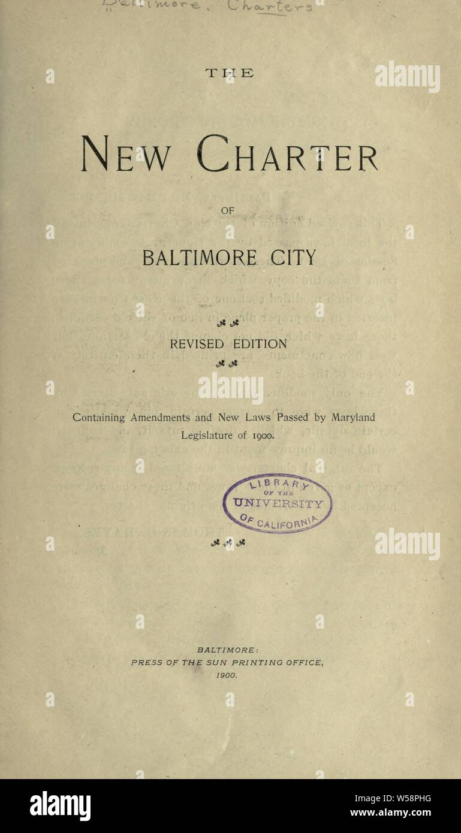
Established in the City Charter
“There shall be a Department of Real Estate, the head of which shall be the Comptroller.”
“For the conduct of the Department, the Comptroller shall appoint a Real Estate Officer and such assistants and employees as may be provided for in the Ordinance of Estimates.”

Slide 3
Functions
Acquisition.
Disposition.
Leasing City Property
Cell Towers/Antennas /Small Cells
Management of Broadway and Ann Street Piers
Sale of Tax Sale Certificates
Vendor’s Lien Program
Regular Tax Sales

Slide 4
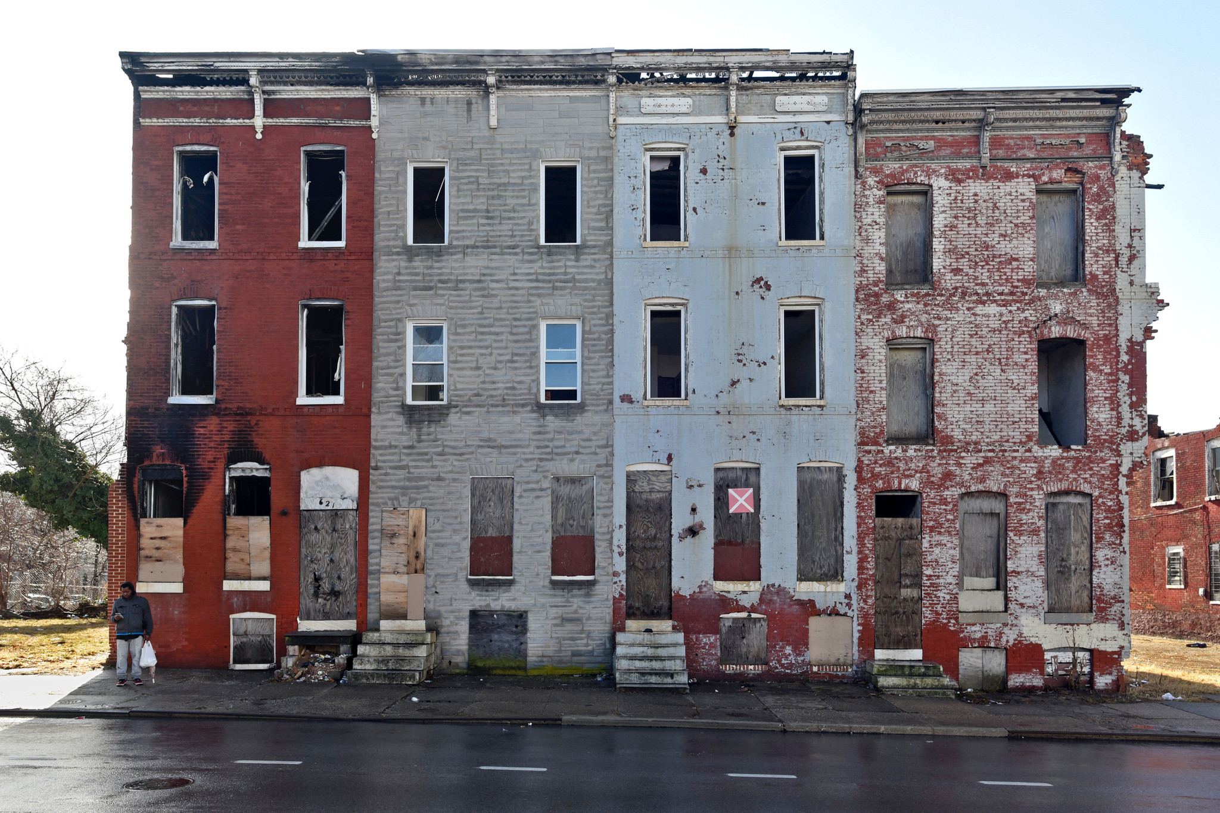
Quick Background
Six months after the Main Tax Sale, unsold certificates are forwarded to the Department of Real Estate
About 1,400 in tax year 2021
Real Estate administers the sale of about 100 certificates, mostly vacant buildings, annually through one of two programs:
Vendor’s Lien
Regular Tax Sale

Slide 5
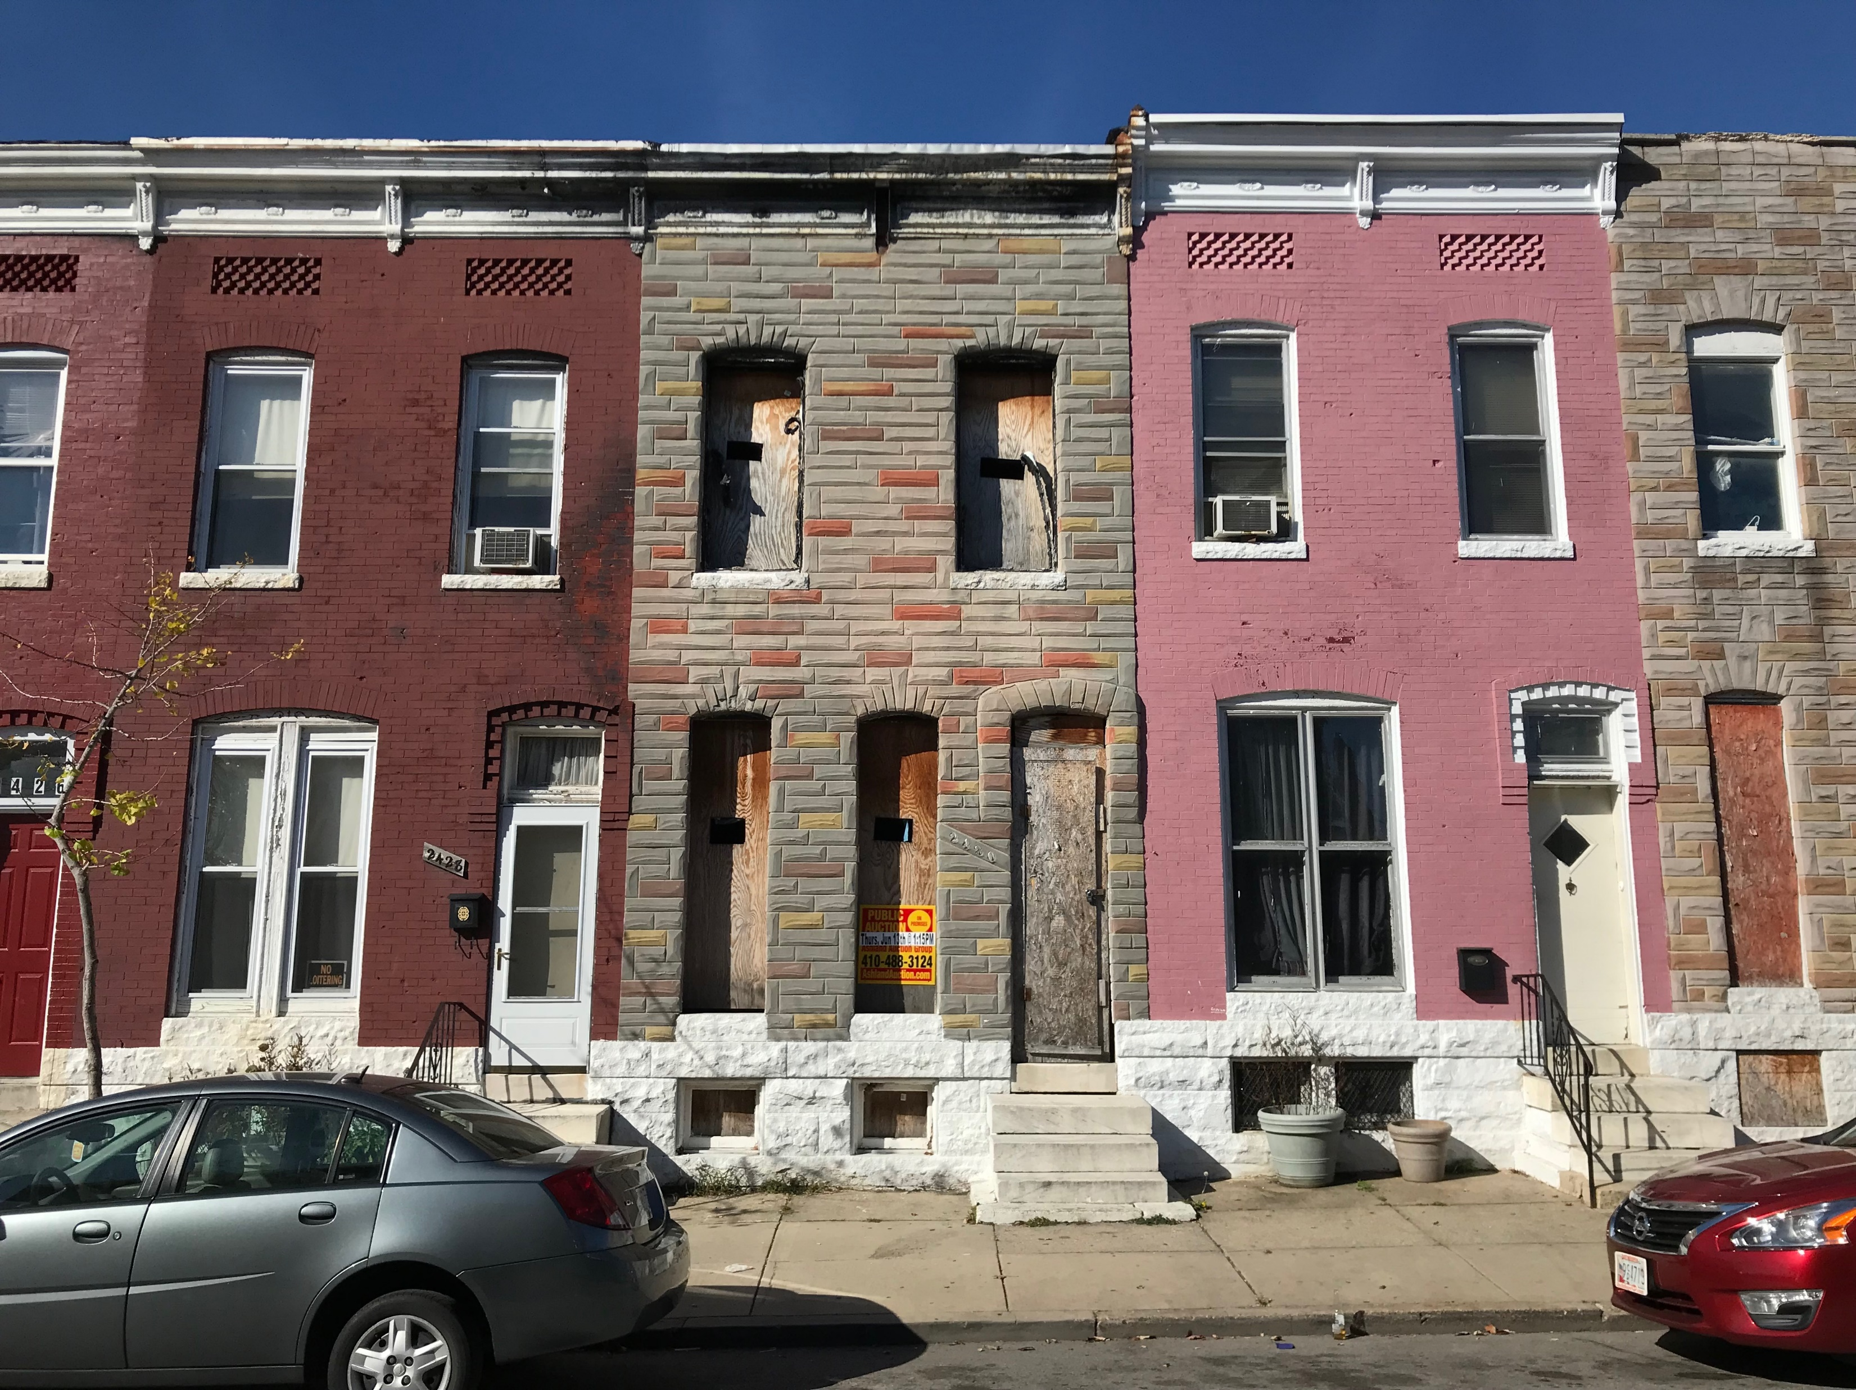
Vendor’s Lien – Tax Sale
The purpose of the Vendor’s Lien Program is to eliminate blight and return the property to the tax roll. This is accomplished through a negotiated reduction in municipal liens on certain properties with tax sale certificates.

Slide 6
Vendor’s Lien - Eligibility
Must have a Vacant Building Notice (VBN) issued by DHCD.
The liens exceed the assessed value.
Liens abated: generally penalties and interest, environmental, demolition, and miscellaneous liens
Liens not abated: Base real estate taxes and water liens.
Tax Sale Certificate Purchase Price equals the greater of the base taxes/water or the assessed value.

Slide 7
Vendor’s Lien – Process
- Purchaser fills out an application
- We ask for evidence of community approval
- We forward the requests to the Planning Department and DHCD for feedback.

Slide 8
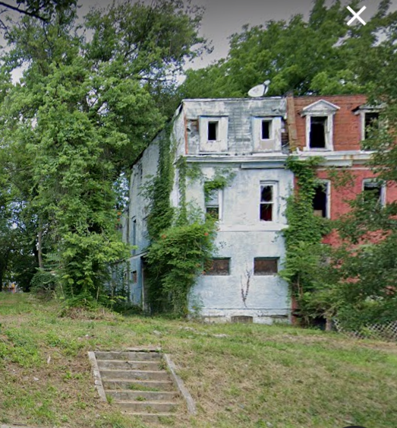
Vendor’s Lien – 2812 Walbrook Avenue
Notes:
We ask the BOE to waive the liens and sell the certificate for $5,667.

Slide 9
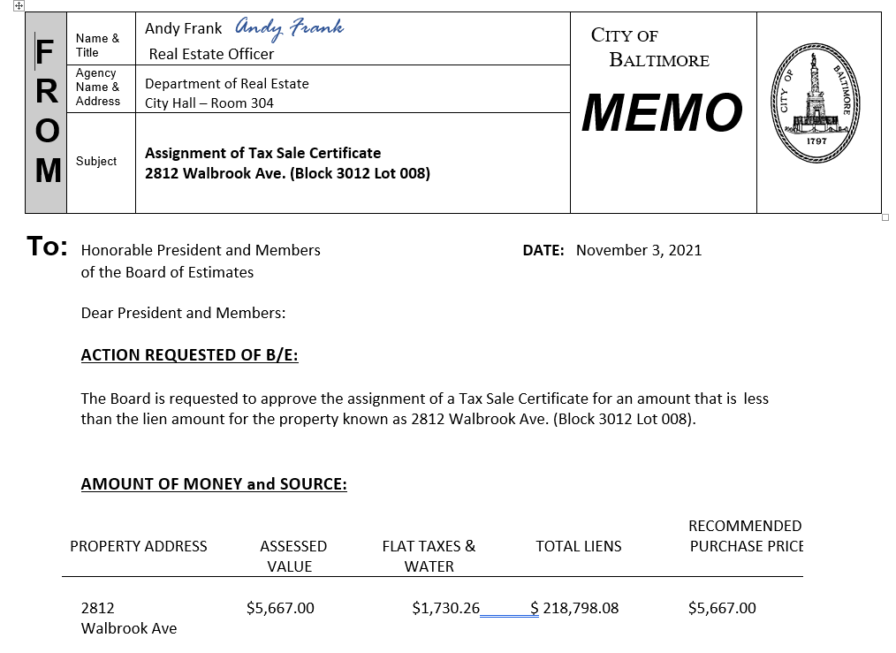
Vendor’s Lien – 2812 Walbrook Avenue
2812 Walbrook Avenue
Assessed Value - $3,000
Municipal Liens
Base Real Estate Taxes - $5,000
Water - $667
Real Estate Taxes Penalties and Interest – $97,283
Misc. Liens – $119,785
Total Liens - $218,798
Certificate Sales Price - $5,667.
Notes:
We ask the BOE to waive the liens and sell the certificate for $5,667.

Slide 10
Regular Tax Sale
We sell the certificate for the face value of the liens plus interest that accrues.
BOE approval is not required.

Slide 11
Considerations
- Water Liens
- Non-profit Developers – Lesser of flat taxes/water liens and assessed value?
Notes:
We ask the BOE to waive the liens and sell the certificate for $5,667.

